Slide 1
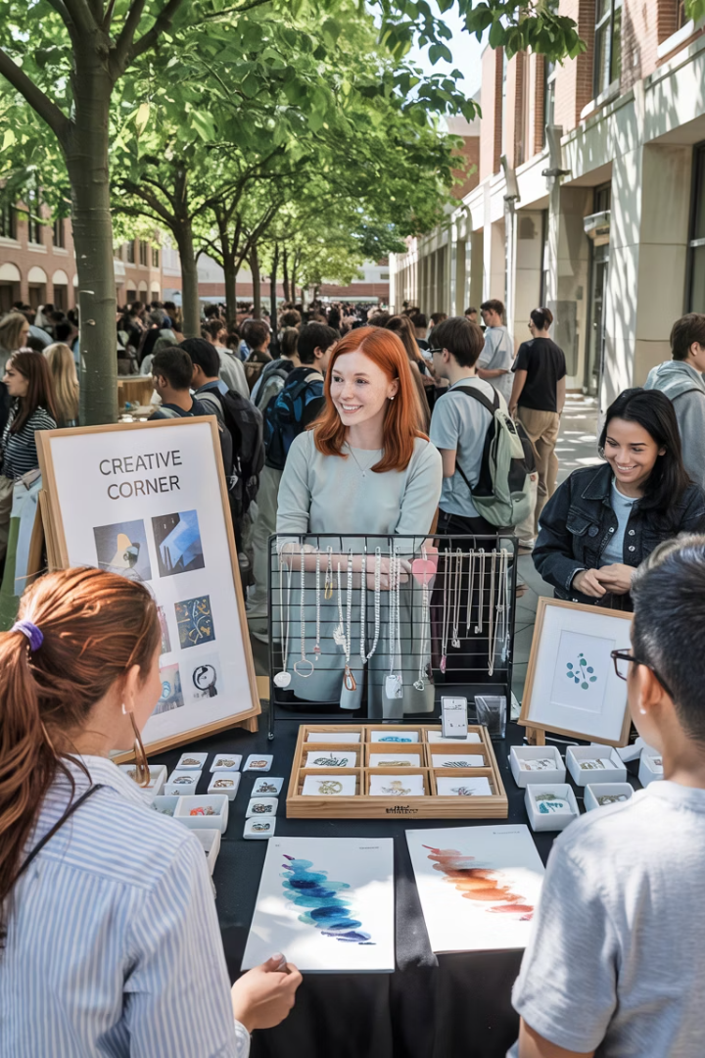
Niner Mine: Student-Powered Marketplace
Welcome to our final presentation on Niner Mine, a student-powered marketplace built at UNC Charlotte where creativity meets community.
Our platform enables students to showcase and sell their creations while connecting buyers with unique campus-made products.

Slide 2
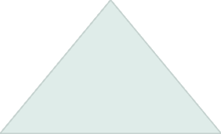





Project Overview & Motivation
Vision
Creating economic opportunities for student creators
Community
Connecting campus creators with buyers
Platform
Full-featured marketplace for student products
Niner Mine addresses the need for student creators to monetize their talents. We've built a complete marketplace solution for the UNC Charlotte community.

Slide 3








Technology Stack
Frontend
Backend
Vite + React
Python (Flask)
Hosting
Database
AWS EC2 with FileZilla for deployment
PostgreSQL via Supabase
Our solution leverages modern technologies. This stack ensures scalability and maintainability for long-term growth.

Slide 4
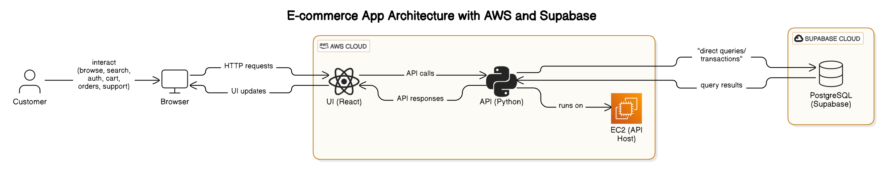





System Architecture
Client
Frontend
Backend API
Data Layer
Browser access by students and buyers
React UI hosted on AWS EC2
Flask middleware handling business logic
PostgreSQL with Stripe payment integration
Our architecture follows industry best practices. The separation of concerns enhances maintainability and scalability.

Slide 5

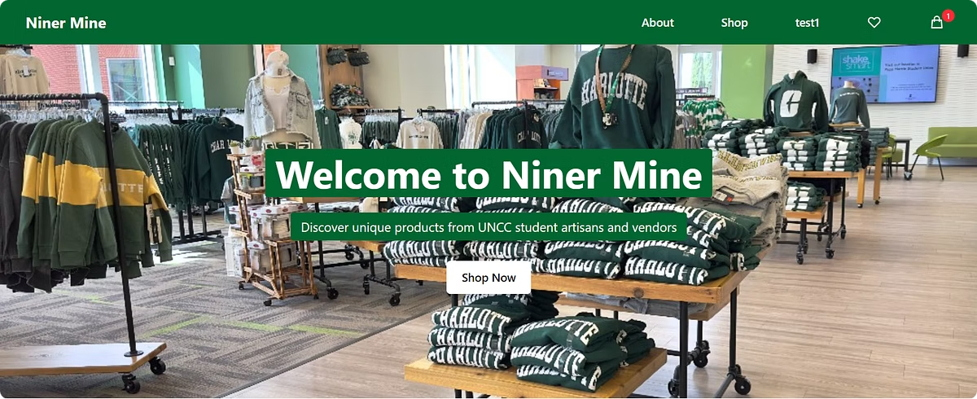
Demo

Slide 6
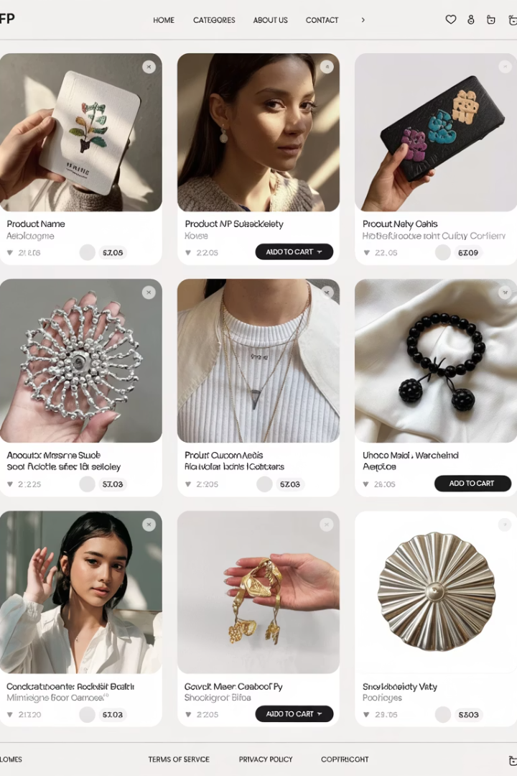
Key Features
Vendor Onboarding
Student creators can register and list products with detailed specifications and images.
Product Discovery
Intuitive browsing experience with categories, search, and filtering options.
Shopping Experience
Add to cart, checkout flow, and secure payment processing via Stripe.
Order Management
Tracking, notifications, and status updates for both buyers and sellers.
These features were all completed in Sprint 3. They form the core functionality of our marketplace.

Slide 7
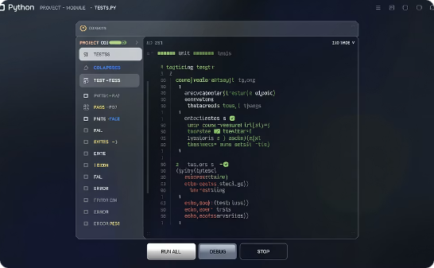
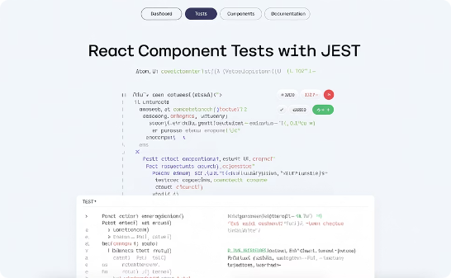
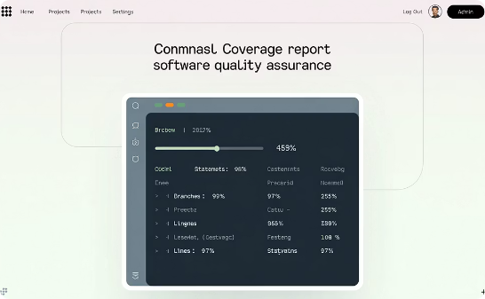
Automated Testing
Backend Tests
Frontend Tests (Coming Soon)
Coverage Reports (Coming Soon)
Flask route testing with mocked database connections ensures API reliability.
React component testing verifies UI behavior across different scenarios.
We maintain above 80% test coverage across critical application paths.
Our testing strategy validates both UI components and backend services. This ensures reliability as we continue development.

Slide 8
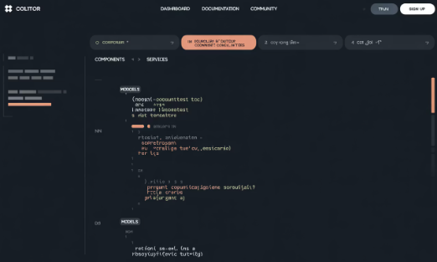
Code Organization
Frontend Structure
Backend Structure
Component-based architecture
Flask blueprints for routing
Redux for state management
Service layer for business logic
Service modules for API calls
Data access layer for database
Responsive design patterns
Third-party integrations (Stripe)
Our code follows clean architecture principles. This modular approach facilitates maintenance and future enhancements.

Slide 9

Next Steps & Conclusion
Campus Integration
Mobile Optimization
Partner with university departments for official endorsement and promotion.
Feature Expansion
Develop responsive design for mobile users and potential native app.
Add ratings, reviews, and recommendation engine to enhance user experience.
Niner Mine successfully delivers a complete marketplace for student creators. Our platform empowers students to showcase talents and build entrepreneurial skills.

Slide 10

Thank you

